Slide 1
Introducing Edgenuity Pathblazer
[Teacher name]
3rd grade

Slide 2
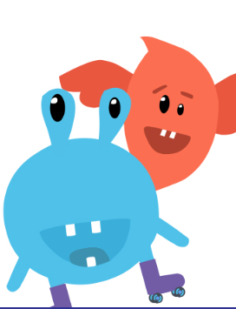
We’re using a program called Edgenuity
Edgenuity is a learning resource that allows you to work through lessons and activities independently at your pace
We’ll also be doing class lessons and I’ll be helping you as you work through your Edgenuity lessons
I’m able to see where you need help and how much time you’re spending on lessons and activities
Take ownership of your learning and ask for help when you need it.

Slide 3
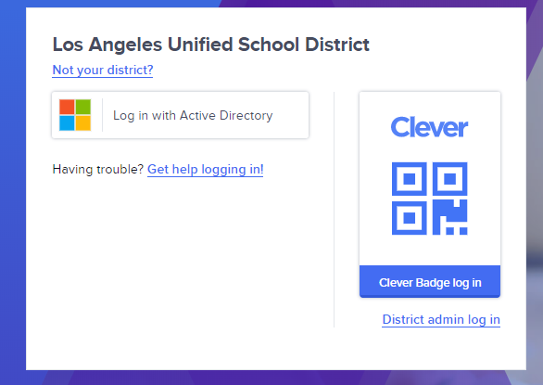
Students go to www.clever.com/in/lausd
Notes:
Demo Student:

Slide 4
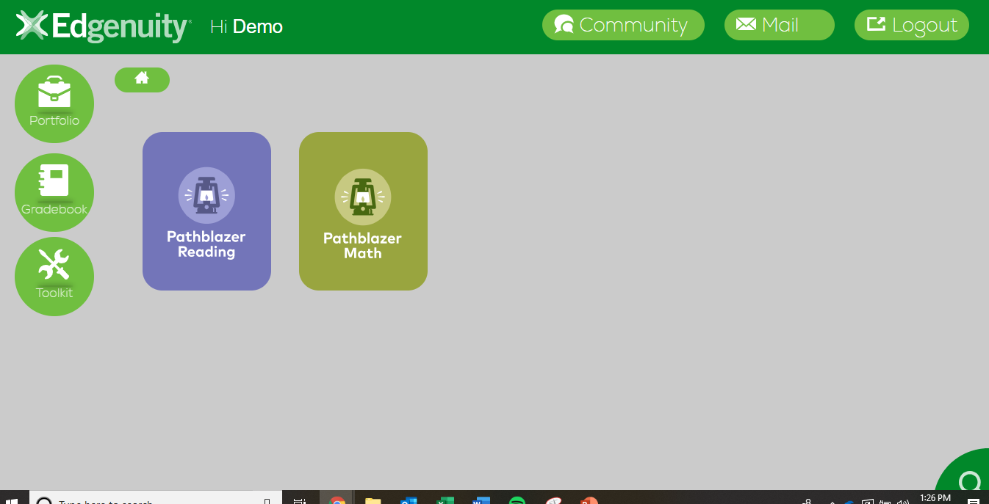
Notes:
Demo Student:

Slide 5
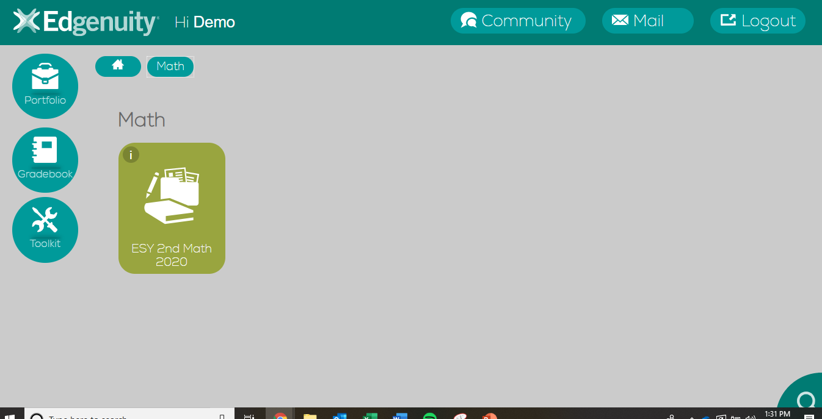
Notes:
Demo Student: demo.esy.second

Slide 6
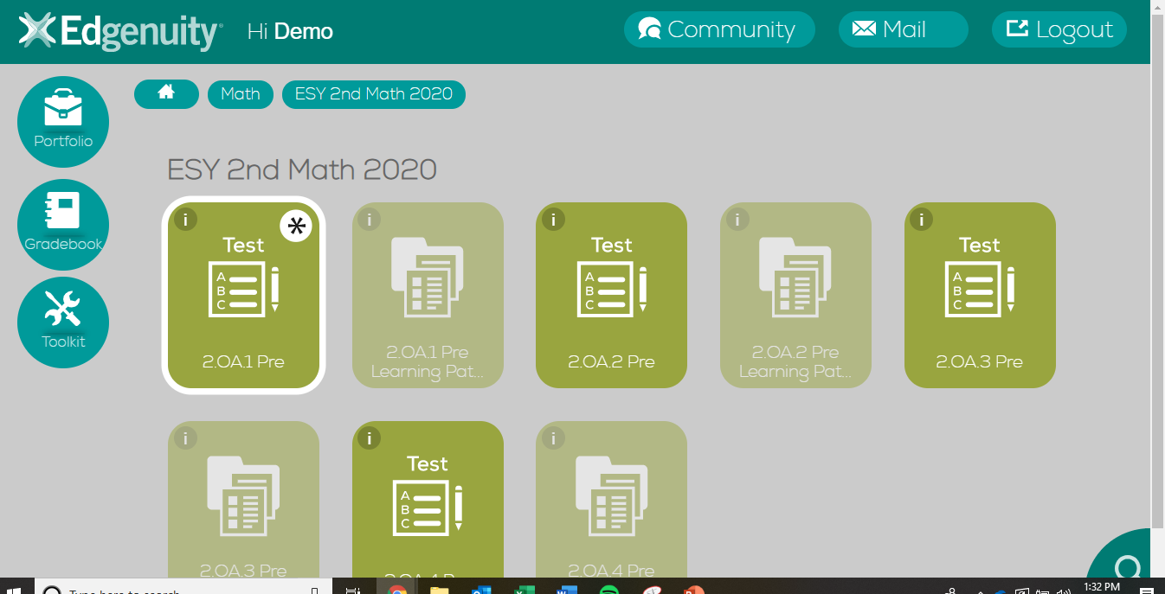
Notes:
Demo Student:

Slide 7
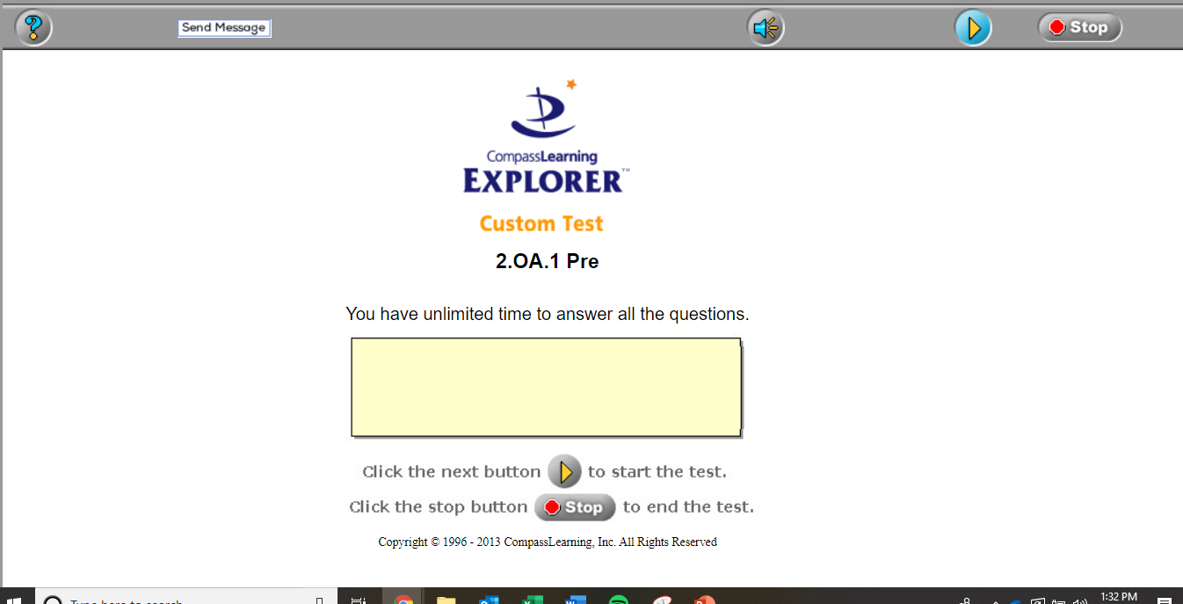
Click the yellow “Play” button to continue
Notes:
Demo Student:

Slide 8
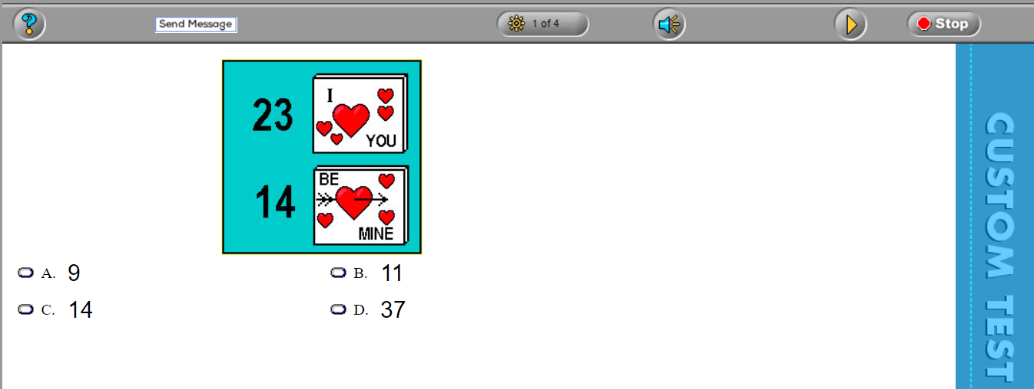
Click “Stop” when finished.
Notes:
Demo Student:

Slide 9
Completed tests will have a check mark.
If the assignment is greyed out, you don’t need to work on that learning path.
Move to the next short test.
Notes:
Demo Student:

Slide 10
An asterisk* shows where you should work next.
Work on your learning path before moving on to the next test.
Notes:
Demo Student:

Slide 11
The Learning Path has instruction and practice activities.
Student scores on quizzes will decide whether they move forward or repeat the lesson once.
Notes:
Demo Student:

Slide 12
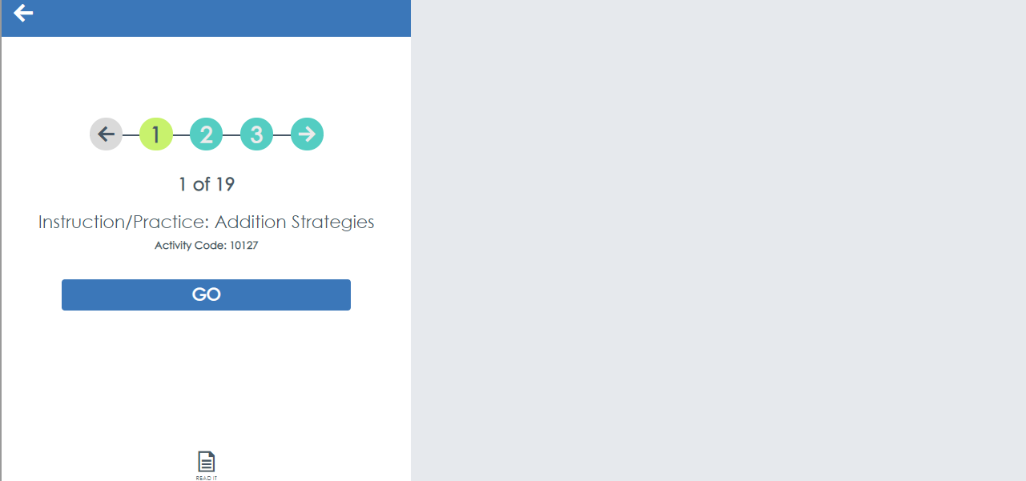
Notes:
Demo Student:

Slide 13
To Exit:
(1) Click the menu button.
Notes:
Demo Student:

Slide 14
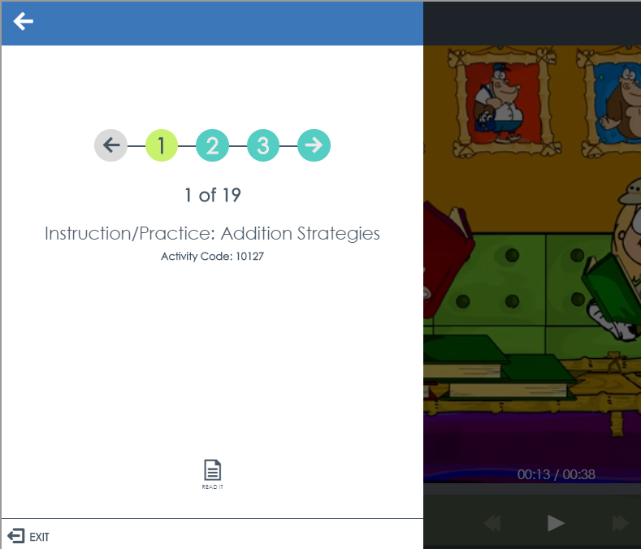
To Exit:
(2) Click the exit button.
Notes:
Demo Student:

Slide 15
How it Works
1. Lesson Pre-test
2. Complete assignments
3. Monitor progress

Slide 16
Edgenuity Expectations
Plan to:
Spend a minimum of __ minutes each day working in Edgenuity
Reach out to me if you have any questions
Pay close attention to lessons and activities. Take your time on quizzes and tests to show what you know.
If you don’t know an answer, it’s okay to get the question wrong. That way we know you need help!

Slide 17
Getting Help
Self
Peers
Teacher
Review instruction
Review missed questions in your portfolio
Ask a classmate for assistance
Post question in class message board
Office Hours are– a link to join is posted in__ Announcement
Send messages by email. I check email throughout the day.

Slide 18
Communication
Class
Student
Send messages by Edgenuity email. I check email throughout the day.
Announcements will be posted in Edgenuity every Monday and Friday.
Each student has been assigned a peer partner to help answer class questions. You will exchange contact information.
Office Hours are from 10:00-11:00. A link to join is posted in the Announcements.

Slide 19
Academic Integrity
Which actions are examples of Academic Integrity?
5. Copying answers from a classmate
2. Citing sources
3. Copy and paste parts of your essay from google
4. Finding the answers to specific questions online
6. Getting help understanding a question from a classmate
1. Doing your own work
7. Finding an alternate explanation of a topic online
8. Using eNotes on Quizzes & Tests

Slide 20
Academic Integrity
I PLEDGE THAT I WILL NOT:
Plagiarize or cheat in Edgenuity
Post assessments, assignments, answer anywhere that can be seen by other students
Allow parents / mentors / guardians to give assistance on assessments.

Slide 21
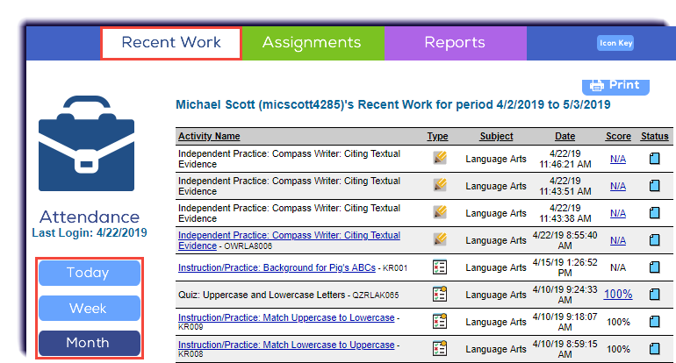
Student Portfolio
Click the Portfolio button. Count blue papers to see how many activities you completed for the day.
Notes:
Analysis of our data has determined that students are most productive and engaged when they work at least 20 min. during each session. In addition, a weekly total of 60-90 min. per subject will ensure students improve at least an additional grade level each year. Setting a goal for number of activities completed and mastered supports student success.

Slide 22
Setting Goals
Aim to complete ____ activities a day with a score of __.
Don’t forget to give yourself breaks when you need them!
Notes:
Analysis of our data has determined that students are most productive and engaged when they work at least 20 min. during each session. In addition, a weekly total of 60-90 min. per subject will ensure students improve at least an additional grade level each year. Setting a goal for number of activities completed and mastered supports student success.

