Slide 1
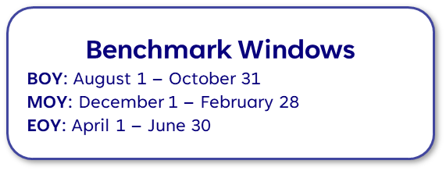

Implementation/Educator Guidelines
Students will
Educators will
Admin will
Goals
Weekly Usage Recommendation
Three times per week
Grade K: 15-minute sessions
Grades 1-5: 20-minute sessions
Instructional Models
All students: lab or one-to-one devices
Small groups: center rotations
Intervention pull-out programs
Before- and After-school Instruction
*At home usage is encouraged
Additional Resources
Click links to view
Introducing students to Imagine Español
Understanding the Imagine Español Placement and Benchmark Tests
Imagine Español Growth Report
Teacher resources for whole-class instruction using Lesson Explorer
End-of-Year Reset for the Imagine Language & Literacy Suite
Stay Connected
Supporting Educators and students while maximizing overall achievement is our goal. Click the link below to access our Learning Library and connect to webinars and training to help you make the most of Imagine Learning programs in your classroom!
Visit Our Customer Learning Library
Need Help?
Email support@imaginelearning.com
Call 1-866-457-8776
Start a live chat
Student Populations
Grades K-5: All students
Educator Actions for Success
Click links to view
Weekly/Bi-weekly
Usage: Are students on track for EOY target?
Student Progress: How are students preforming on each unit?
Skills Inventory: How are students performing on specific skills?
Portfolio: Engage with student artifacts
Student Placement Test
Automatically administered one time when the student logs into the program for the first time

